Slide 1
K Nearest Neighbour
KNN (K-Nearest Neighbors) is a simple, non-parametric, supervised machine learning algorithm used for both classification (predicting categories) and regression (predicting values) by classifying new data points based on the majority class or average value of their 'k' closest neighbors in the training data.
It relies on distance metrics like Euclidean distance to find proximity.
It's known as a "lazy learner" because it doesn't build a model during training but rather memorizes the dataset, making decisions only when a prediction is needed.

Slide 2
When K is small, we are restraining the region of a given prediction and forcing our classifier to be “more blind” to the overall distribution.
A small value for K provides the most flexible fit, which
will have low bias but high variance.
Larger values of K will have smoother decision boundaries
which means lower variance but increased bias.

Slide 3
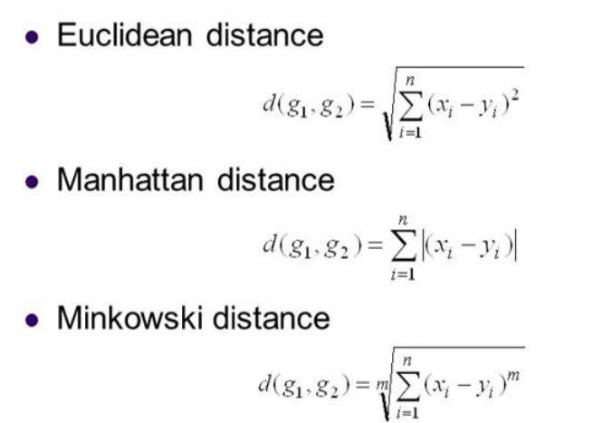
Distance Measure

Slide 4
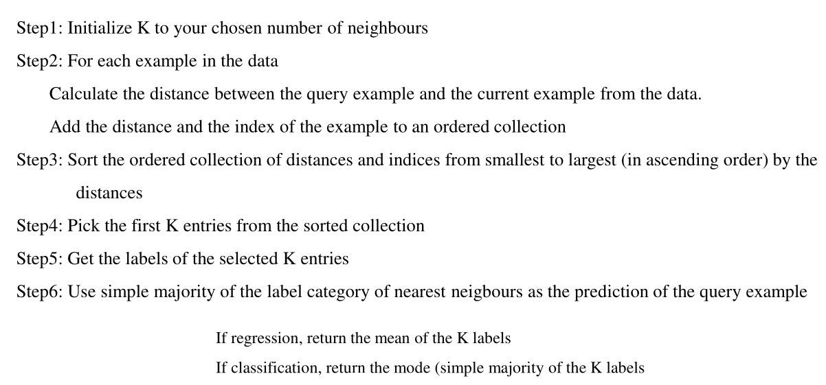
KNN Algorithm

Slide 5
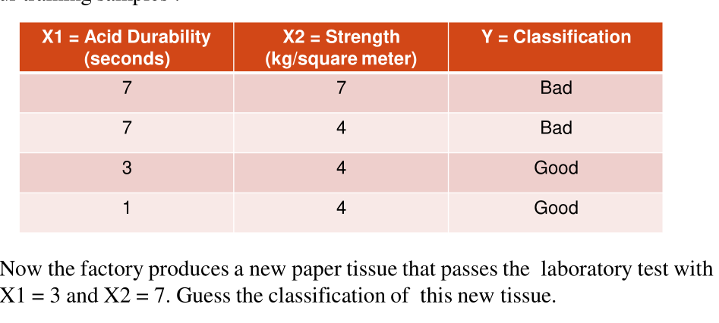
KNN- Classifier
Classify the following by considering the value of K=3

Slide 6
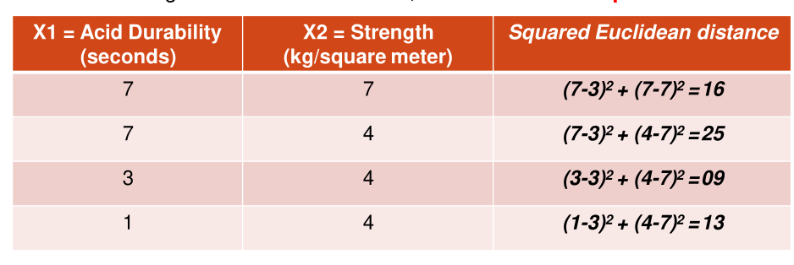
Use Euclidean Distance measure

Slide 7
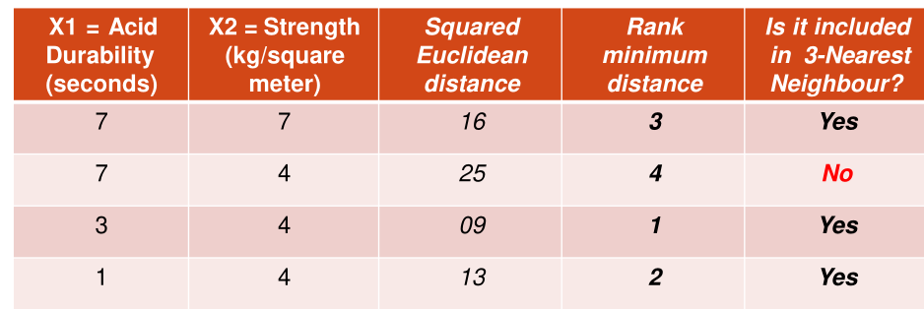

Slide 8
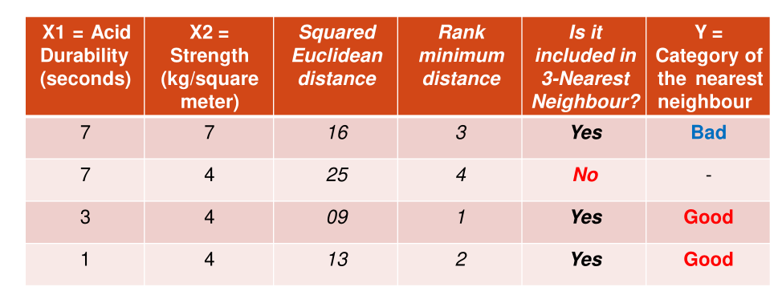
- In the above example,take the square root for the squared euclidean distance(As per euclidean distance formula) and rank it.

Slide 9
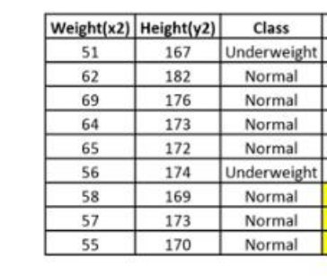
What will be the category for weight=57 and height = 170, considering k=3?

Slide 10
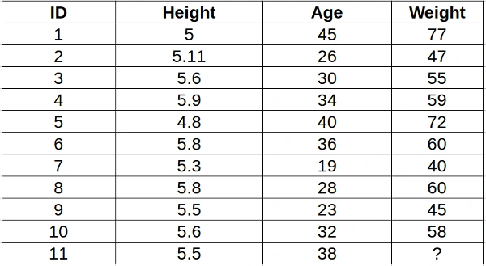
KNN - Regressor
Find the weight(Target Class) for the height=5.5 and age =38, with k=5.

